Slide 1


Your Awesome
Company
Skills Assessment Challenge Deck
Showcase your skills
Take our skills assessment challenge brief to find
how well you fit the role

Slide 2

Hello there!
Congratulations on passing
your initial interviews!
We're moving forward to the next stage of your application process: the skills assessment challenge.
This challenge is an avenue for you to demonstrate your expertise, so take your time and create your best output yet.
Should you have any questions, send us a message. Good luck!
Drag and drop your photo or video! Click the sample photo or video and delete. Select yours from the Uploads tab, drag, and then drop inside the frame!

Slide 3

What this Challenge Brief contains:
04 | Your Awesome Company in a Nutshell
08 | The Role We're Looking to Fill
09 | The Skills Assessment Challenge
14 | Tips to Conquer the Challenge
16 | A Message From our Team Lead
Use links to go to a different page inside your presentation.
Highlight the text you want to hyperlink, click the link symbol that appears above that text, then select from the dropdown the page that you want to connect.
Your Awesome
Company

Slide 4

Your Awesome Company in a Nutshell
Write a short company overview
Briefly introduce your company's story. List down its offered products or services. Share facts about the company size
and locations.
Drag and drop your photo or video! Click the sample photo or video and delete. Select yours from the Uploads tab, drag, and then drop inside the frame!
Back to Challenge Brief Overview

Slide 5
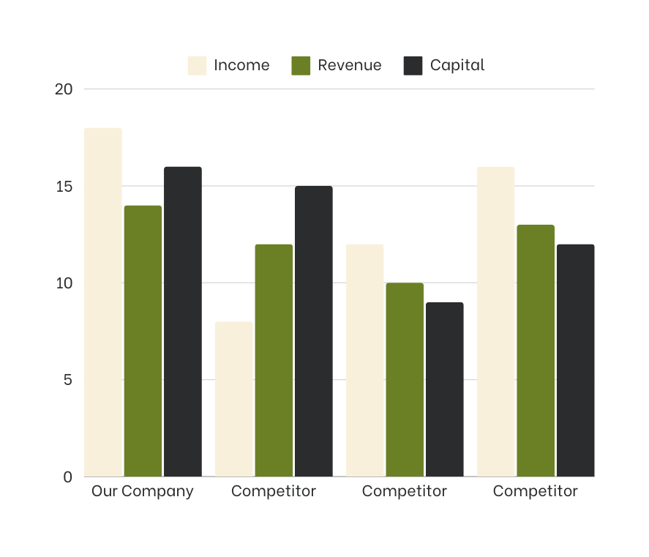

Our financial metrics are
the best in the market.
19 out of 21 individuals rely
on our products and services.
Back to Challenge Brief Overview

Slide 6



Our mission, vision, and values have remained unchanged since our foundation.
Mission
What is the company’s future direction and ambition?
What guides the employees and the work they do?
Vision
What are the company’s ultimate goals?
What is the impact that it wants to leave in the local and global community?
Values
What are the principles and philosophies driving the company? What are its non-negotiable standards?
Back to Challenge Brief Overview

Slide 7
This is what we're doing to achieve our goals.
Step 1
Elaborate on the step.
Step 2
Elaborate on the step.
Step 4
Elaborate on the step.
Step 3
Elaborate on the step.
Back to Challenge Brief Overview

Slide 8

To reach our targets, we need unique individuals. This is where you come in!
Add the name of the role here
Include an overview of the role profile
and primary responsibilities. You can opt
to use bullet points
Add as many as needed
Back to Challenge Brief Overview

Slide 9

If you're ready, let's begin!
The Skills Assessment Challenge
Back to Challenge Brief Overview

Slide 10
A Bit of Context
The level of information shared in this skills assessment is not intended to be fully comprehensive. This challenge intends to understand your thought process, questions, and recommendations.
Add other essential notes to help the candidate succeed in this challenge.
Use bullet points if appropriate.
Add as many as you need.
Drag and drop your photo or video! Click the sample photo or video and delete. Select yours from the Uploads tab, drag, and then drop inside the frame!
Back to Challenge Brief Overview

Slide 11



Part 1
Instructions
Deliverables
Assessment
Outline the steps for this part of the challenge. Be thorough but concise.
Add as many steps as needed.
What is the expected output?
Include any necessary information, such as submission guidelines.
What are the criteria for assessment?
You can opt to use bullet points.
Expound on the criteria as needed.
Back to Challenge Brief Overview

Slide 12

Part 2
Instructions
Outline the steps for this part of the challenge.
Be thorough but concise. Add as many steps as needed.
Deliverables
What is the expected output? Include any necessary information, such as submission guidelines.
Assessment
Drag and drop your photo or video! Click the sample photo or video and delete. Select yours from the Uploads tab, drag, and then drop inside the frame!
What are the criteria for assessment? You can opt to use bullet points. Expound on the criteria as needed.
Add reference photos as needed.
Back to Challenge Brief Overview

Slide 13
Part 3
Deliverables
Instructions | Instructions | Instructions
01 | 02 | 03
Write the first step. | Write the second step. | Write the third step.
What is the expected output?
Include any necessary information,
such as submission guidelines.
Assessment
What are the criteria for assessment?
You can opt to use bullet points.
Expound on the criteria as needed.
Back to Challenge Brief Overview

Slide 14




Tips for Conquering
The Challenge
Back to Challenge Brief Overview

Slide 15
We're sure you've got this in the bag;
nonetheless, here are some tips that might help!
1 | Show your true self | Since the goal of this challenge is to get to know your thought processes, we highly encourage you to be your authentic self. We love diversity, individuality, and self-expression - yours included!
2 | Avoid overthinking | We know how intimidating it is to be out of your depth and work on challenges you might not have seen before. But we've all been there! All you need to do is relax and let your mind do what it does best.
3 | Arm yourself with knowledge | Researching information beforehand is akin to ensuring you're not going into battle empty-handed. To help you, we've prepared all the resources you might need in this link.
Customize this table! Just right-click on any cell to see all the available table functions. To merge, first highlight two or more cells, then click "Merge Cells" to organize your table according to your needs!
Back to Challenge Brief Overview

Slide 16

Here's a special message
to set you on the right track.
WRITE NAME HERE
Write position here
Back to Challenge Brief Overview

Slide 17


Thank you for your continued interest in joining our team!
We look forward to hearing from you.
For questions, reach out to us:
Email
Phone
hello@reallygreatsite.com
(123) 456 7890
Our company welcomes people of all colors, genders, and beliefs.

Slide 18



















Resource
Page
Use these design resources
in your Canva Presentation.
Happy designing!
Delete or hide this page
before presenting.

Slide 19
Resource
Page
B for blur | C for confetti
D for a drumroll | M for mic drop
O for bubbles | Q for quiet
U for unveil | Any number from 0-9 for a timer
Find the magic and fun in presenting with Canva Presentations. Press the following keys while on Present mode!
Delete or hide this page
before presenting.

Slide 20
Resource
Page
Click the Share button on the top right corner of your screen and select 'Present and Record.'
Click ‘Go to recording studio,’ where you can choose the video and audio source for your video presentation.
Feel free to choose the ‘No camera’ option and record your voice only.
Start recording, and press pause in between takes if you have to.
Once you're done, download your Canva Presentation in MP4 file format or get a link to your Talking Presentation and share it with others.
You can also record a video inside the editor! Go to 'Uploads' and click on 'Record yourself'.
Presenting live not your thing?
No worries! Record your Canva Presentation your audience
can watch at their own pace.
Don't forget to delete or hide this page before presenting.

